Slide 1

SALES FORECASTING
IMARTICUS PRODEGREE IN DATA SCIENCE
Capstone Project
Group 3
Lav Ishan | Rashmi Deshmukh | Ketan Chaturvedi

Slide 2
Project analysis slide 6
OBJECTIVE
Conduct state wise trend analysis of the given sales.
To identify other reasons if they are influencing Pesticide Sales.
To provide state wise forecast of Pesticide sales for ABC Manufacturing .

Slide 3

Project analysis slide 2
APPROACH
Provide insights for sales for next
2 years
Observe and Understand State wise Trend
Time Series Forecasting
Perform State wise Sales Forecast
Design different Forecasting Models
Test the best Model
Select the best Model

Slide 4



Project analysis slide 3
SOFTWARE TOOLS
MICROSOFT EXCEL
TABLEAU
PYTHON
Data Reading and basic Alterations
Data Visualisation, EDA and Dashboarding.
Time Series Model Formation

Slide 5
Project analysis slide 4
ASSUMPTIONS OF DATA
The Sales data is present from year 2014-2017
Pesticides Sales data has been provided for 5 states namely Haryana , Punjab, Uttar Pradesh, Uttarakhand and Himachal Pradesh
No missing data
District and state level data is not significant
No extreme values in state wise data
No External factors present in data which could be influencing the sales
For 2017 , data is not present for Feb and Mar
The Sales data is present from year 2014-2017

Slide 6

Project analysis slide 4
state wise trend analysis OF GIVEN SALES
The Sales data is present from year 2014-2017

Slide 7
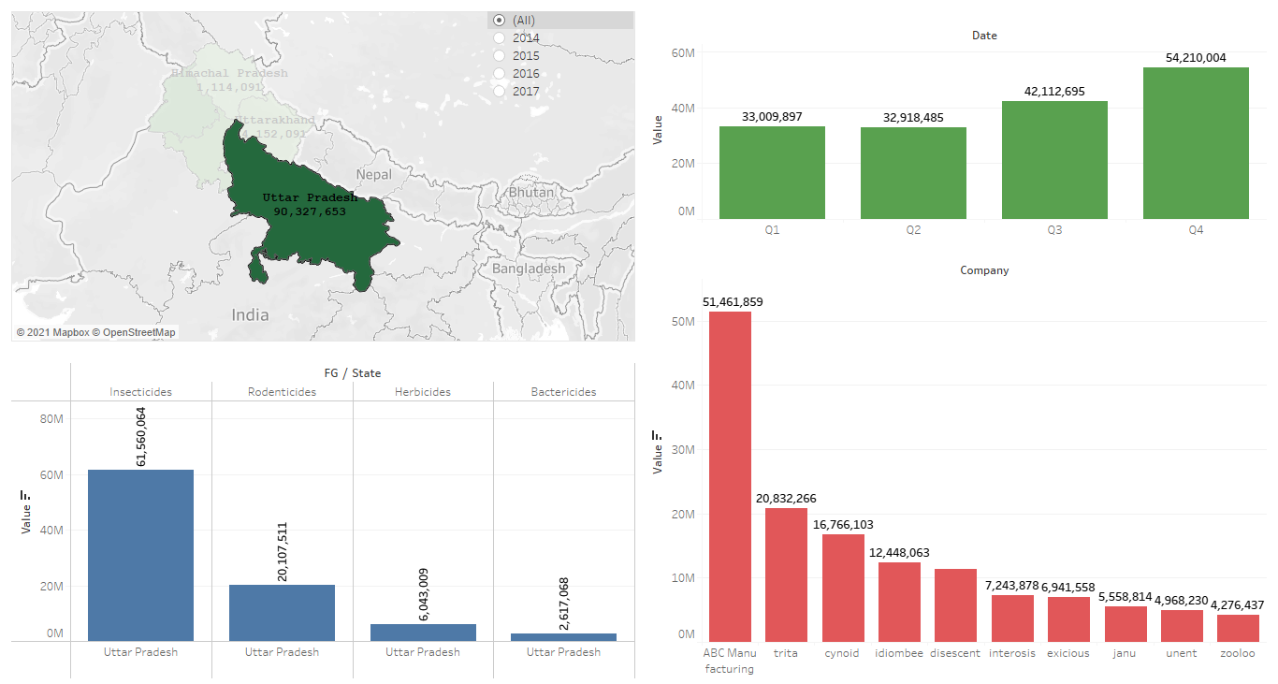
Project analysis slide 4
UTTAR PRADESH
UP has highest demand of Insecticides among all pesticides.
From Q1 to Q4, the trend for demand of pesticides is continuously increasing.
ABC Manufacturing is market leader in UP with more than 50% of market share among all pesticide providers.

Slide 8
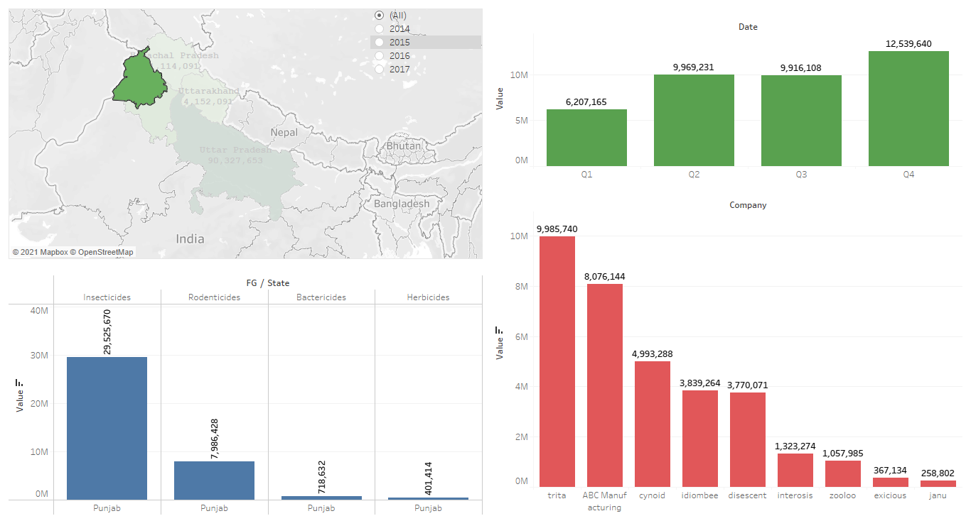
Project analysis slide 4
PUNJAB
Punjab is the second state after Uttar Pradesh with sales of Pesticides.
Here, Trita is the top company to sale pesticides followed by ABC Manufacturing.
Same like UP, insecticides sold highest in Punjab
There is increasing trend in sales from Q1 to Q4 with sales in Q2 and Q3 approximately similar.

Slide 9
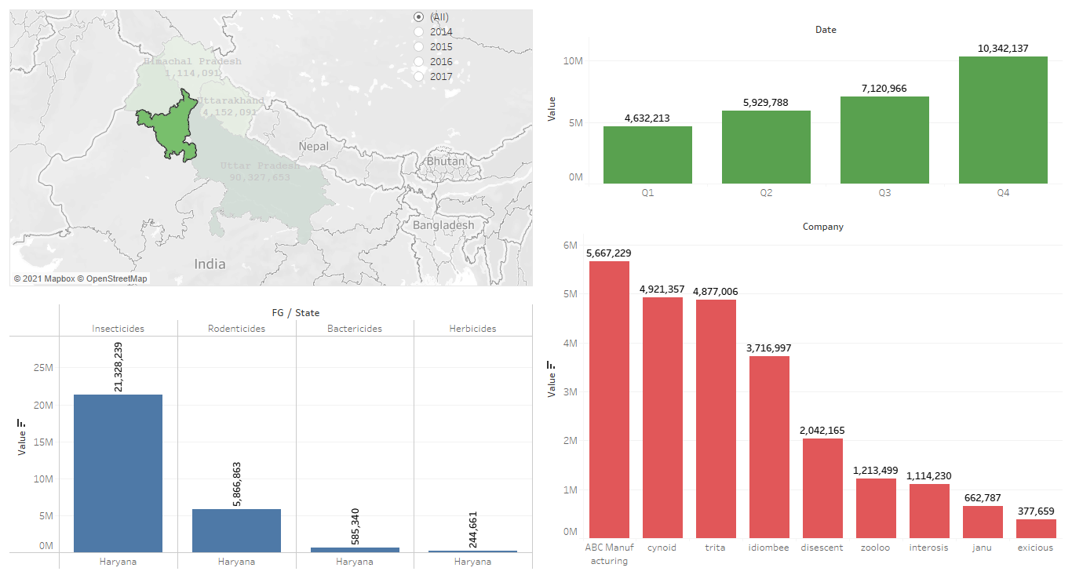
Project analysis slide 4
HARYANA
Haryana is the third state with sales of Pesticides.
ABC Manufacturing is the top company to sale pesticides.
Also, insecticides were sold highest in as compared to other pesticides.
Again, from Q1 to Q4 there is increasing trend in sale of pesticides.

Slide 10
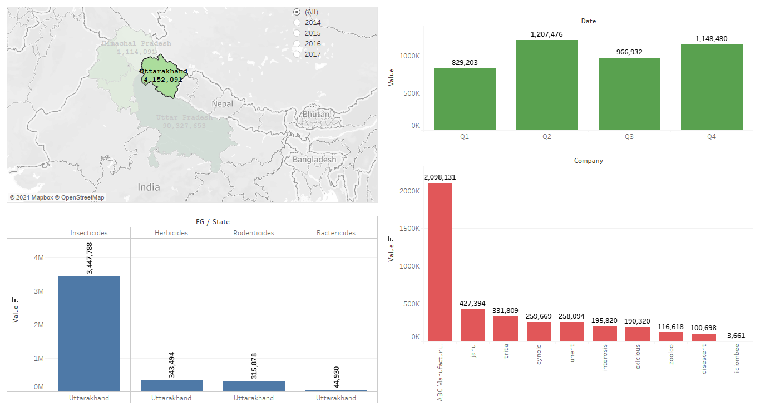
Project analysis slide 4
Uttarakhand
Uttarakhand
Uttarakhand is the fourth state with sales of Pesticides.
ABC Manufacturing is the top company to sale pesticides.
Also, insecticides were sold highest in as compared to other pesticides, followed by Herbicides.
Here, sales are highest in Q2 followed by Q4, Q3 and Q1

Slide 11
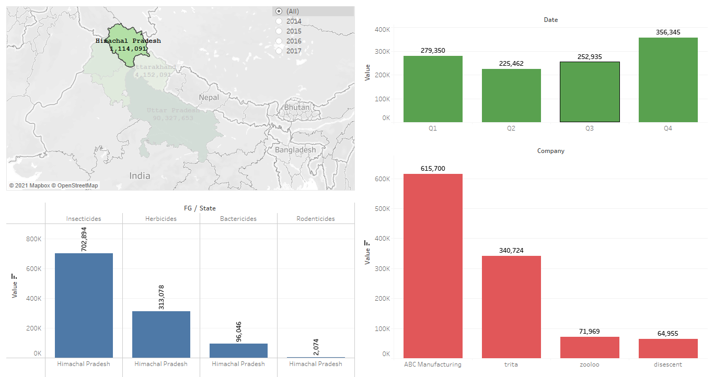
Project analysis slide 4
HIMACHAL PRADESH
Lowest sales of pesticides took place in Himachal Pradesh
ABC Manufacturing is the top company to sale pesticides
Also, out of top 10 companies in this region, only 4 companies are active in Himachal Pradesh. ABC Manufacturing emerged as the market leader in Himachal Pradesh

Slide 12
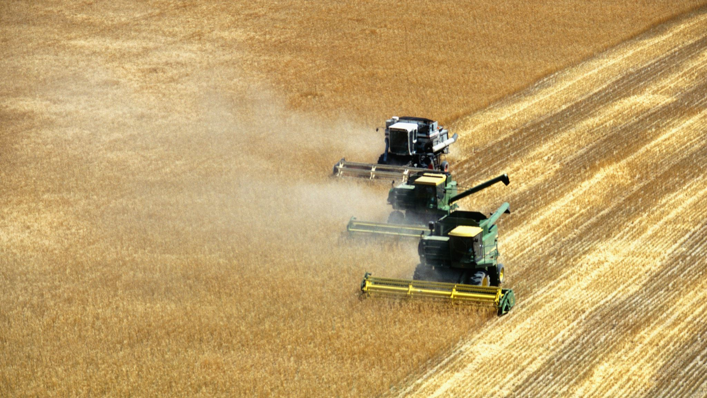
PESTICIDES SALES

Slide 13
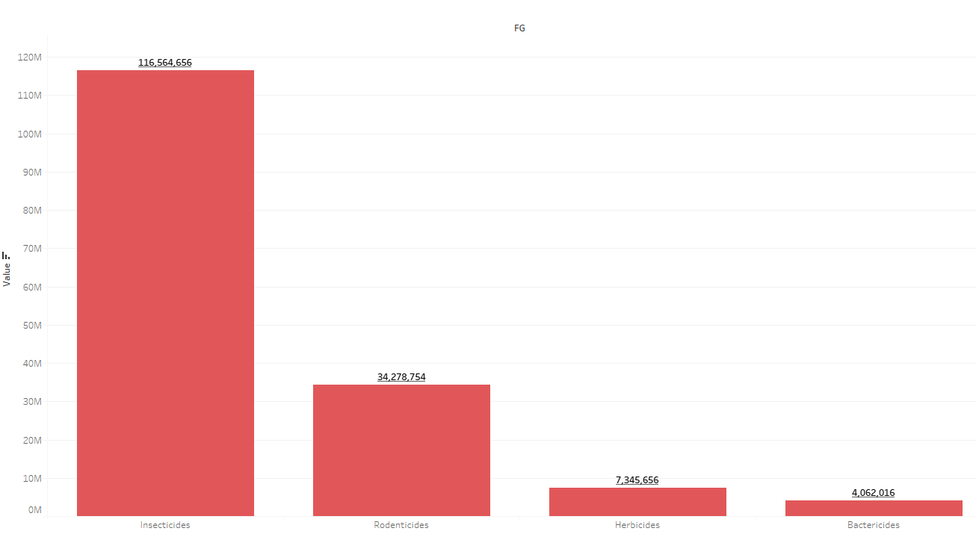
Project analysis slide 4
OVERALL
PESTICIDES SALES
Over a period of 4 years from 2014 - 2017, Insecticides are sold highest followed by Rodenticides, Herbicides and Bactericides

Slide 14
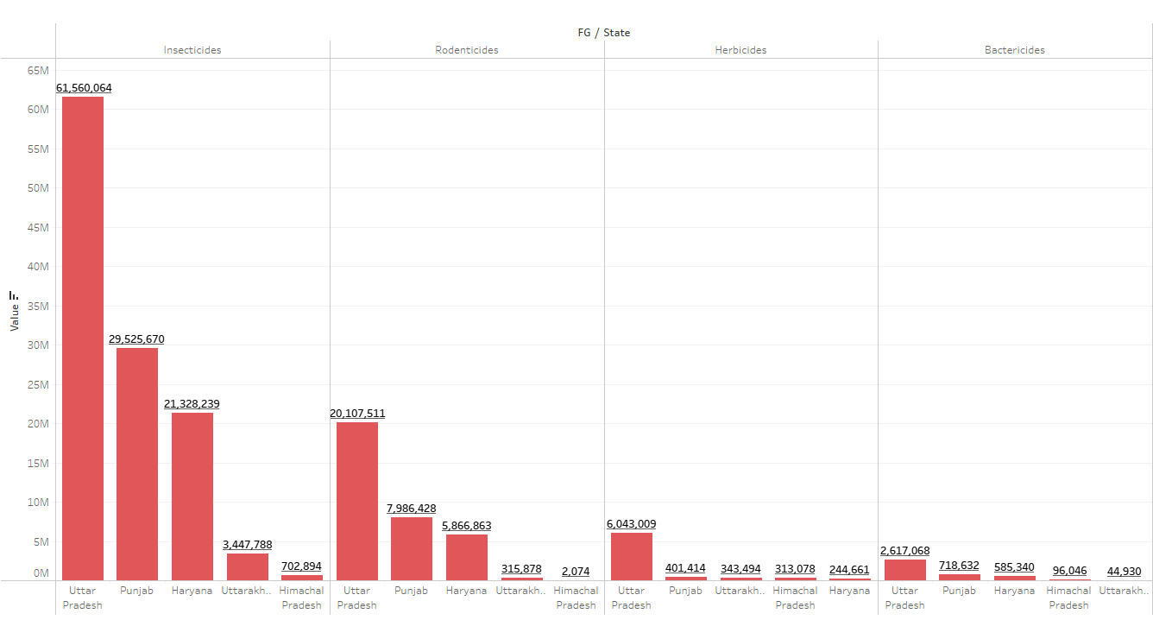
Project analysis slide 4
STATE WISE RANK
PESTICIDE SALES
Uttar Pradesh and Punjab are constantly ranked 1st and 2nd irrespective of the type of pesticides.
Only in the case of Herbicides, the sales in Haryana are lowest, otherwise in other 3 pesticides Haryana in ranked at 3rd position constantly.
Pesticide | Rank 1 | Rank 2 | Rank 3 | Rank 4 | Rank 5
Insecticide | Uttar Pradesh | Punjab | Haryana | Uttarakhand | Himachal Pradesh
Rodenticide | Uttar Pradesh | Punjab | Haryana | Uttarakhand | Himachal Pradesh
Herbicide | Uttar Pradesh | Punjab | Uttarakhand | Himachal Pradesh | Haryana
Bactericide | Uttar Pradesh | Punjab | Haryana | Himachal Pradesh | Uttarakhand

Slide 15
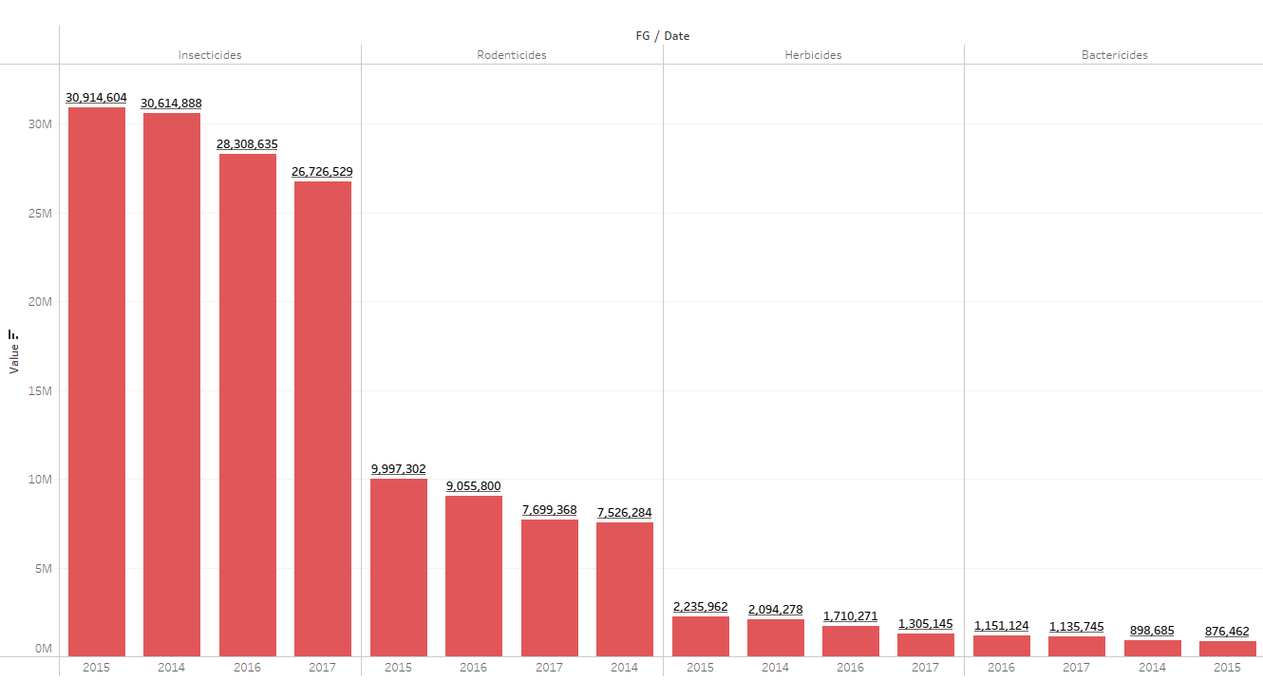
Project analysis slide 4
PRODUCT WISE RANK
PESTICIDE SALES
Pesticide | 2014 | 2015 | 2016 | 2017 | Total Sales
Insecticide | 2 | 1 | 3 | 4 | 116,564,656
Rodenticide | 4 | 1 | 2 | 3 | 34,278,754
Herbicide | 2 | 1 | 3 | 4 | 7,345,656
Bactericide | 3 | 4 | 1 | 2 | 4,062,016

Slide 16
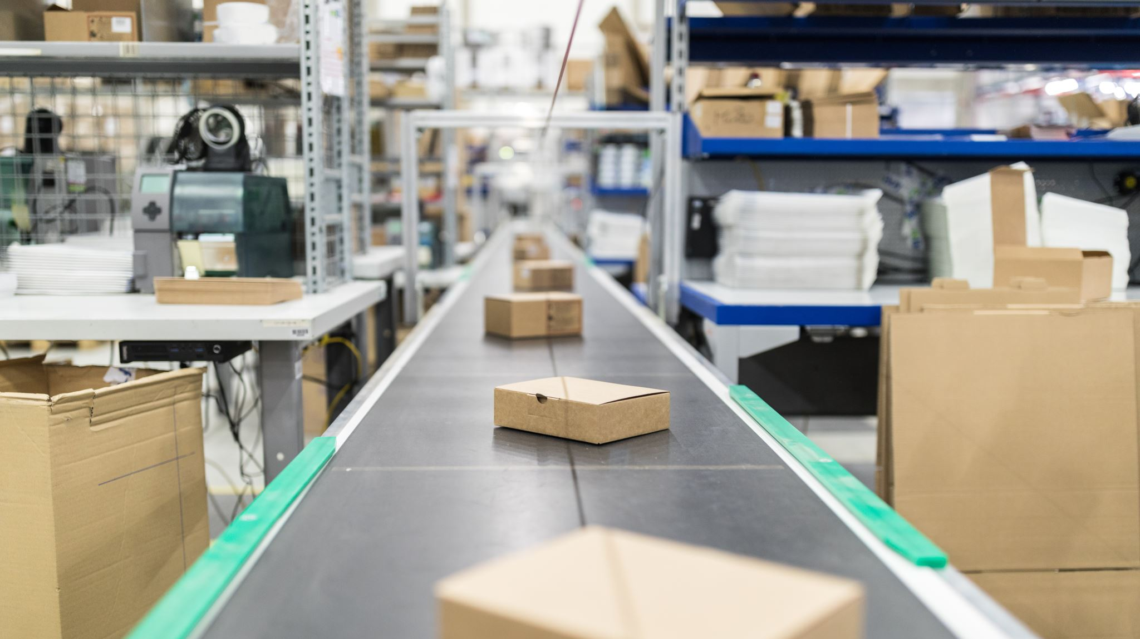
KEY POINTS FOR ABC MANUFACTURING

Slide 17
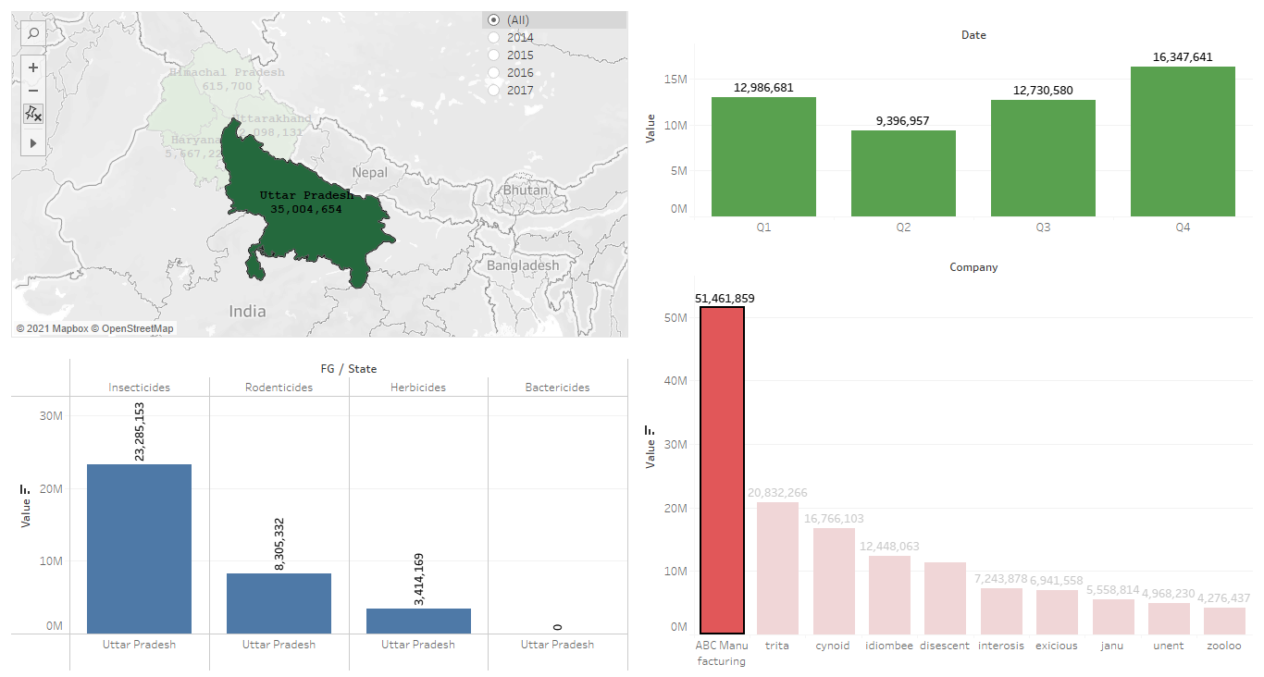
Project analysis slide 4
UTTAR PRADESH
The sales for ABC Manufacturing are highest for Insecticides followed by Rodenticides and Herbicides.
ABC Manufacturing does not deal in Bactericides as there is zero sales of same for 2014-2017.

Slide 18
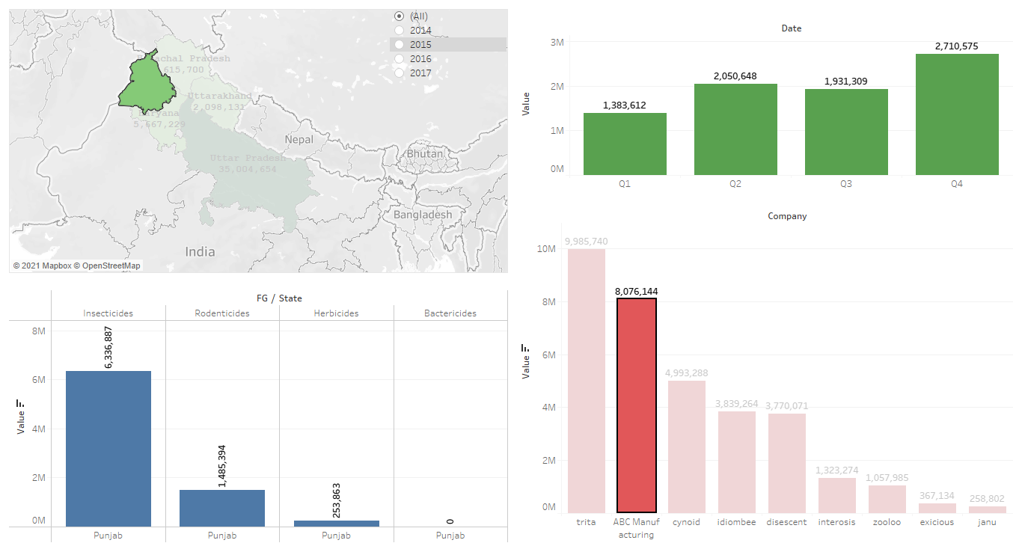
Project analysis slide 4
PUNJAB
ABC Manufacturing is at second position in pesticides sales in Punjab.
Like UP, in Punjab also the company does not deal in Bactericides.
Also, the highest sales are of Insecticides in Punjab which is like Uttar Pradesh.

Slide 19
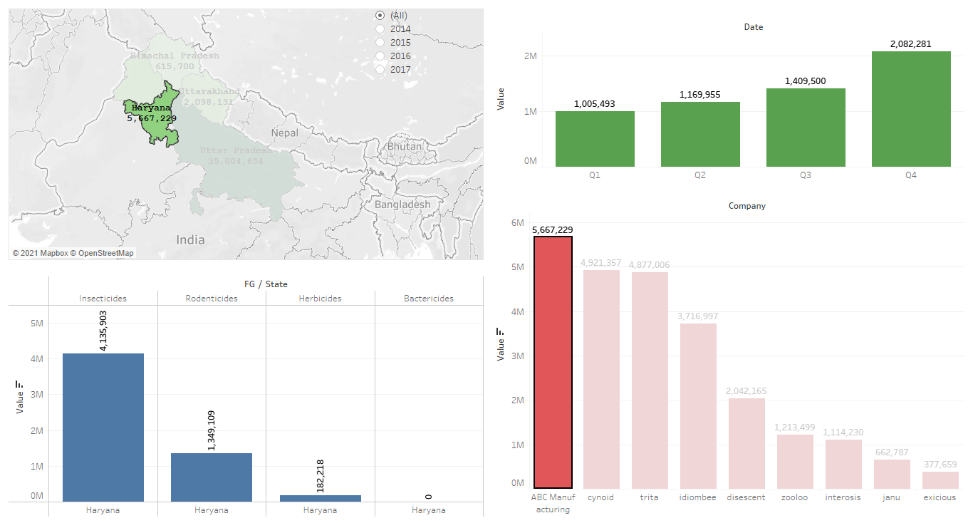
Project analysis slide 4
HARYANA
ABC Manufacturing is market leader in pesticides sales in Haryana.
In Haryana also the company does not deal in Bactericides.
Also, the highest sales are of Insecticides which is like other states.
It can be seen in graphs below that in last two years that is 2016 and 2017, ABC Manufacturing slips to 2nd and 3rd position, respectively. From this it can be seen that the level of impact of ABC is decreasing in Haryana and they have to work to rebuild there position in market.

Slide 20
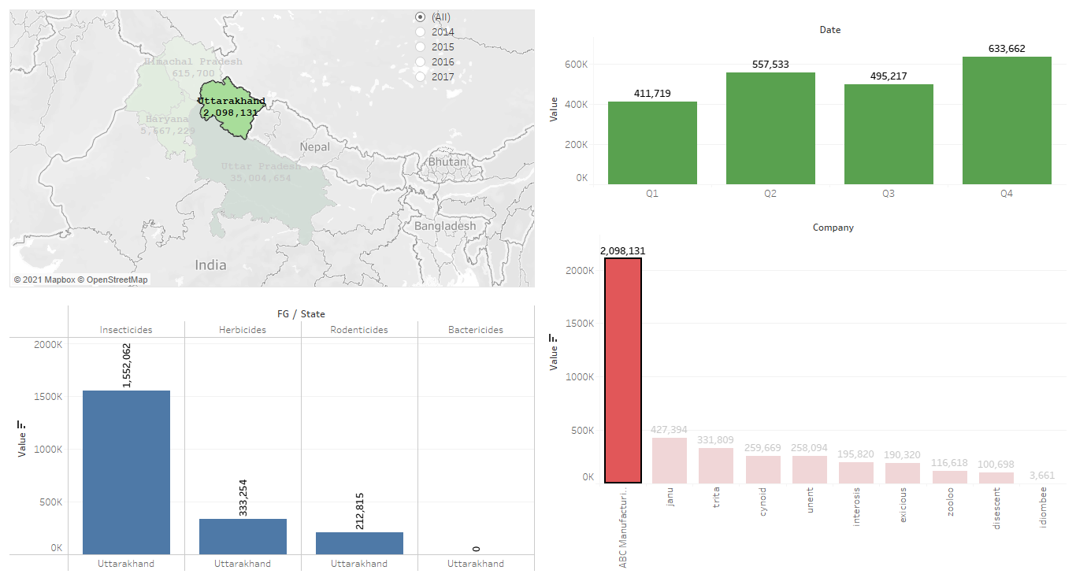
Project analysis slide 4
Uttarakhand
Uttarakhand
ABC Manufacturing is market leader in pesticides sales.
Here also the company does not deal in Bactericides.
Also, the highest sales are of Insecticides which is like other states.
After insecticide, herbicides are in more demand as compared to rodenticides.

Slide 21
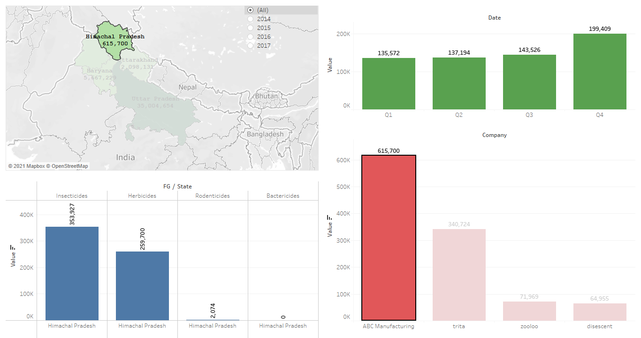
Project analysis slide 4
HIMACHAL PRADESH
ABC Manufacturing is market leader in pesticides sales.
Here also the company does not deal in Bactericides.
Also, the highest sales are of Insecticides which is like other states.
Like Uttarakhand, in Himachal Pradesh also after insecticide, herbicides are in more demand as compared to rodenticides.

Slide 22
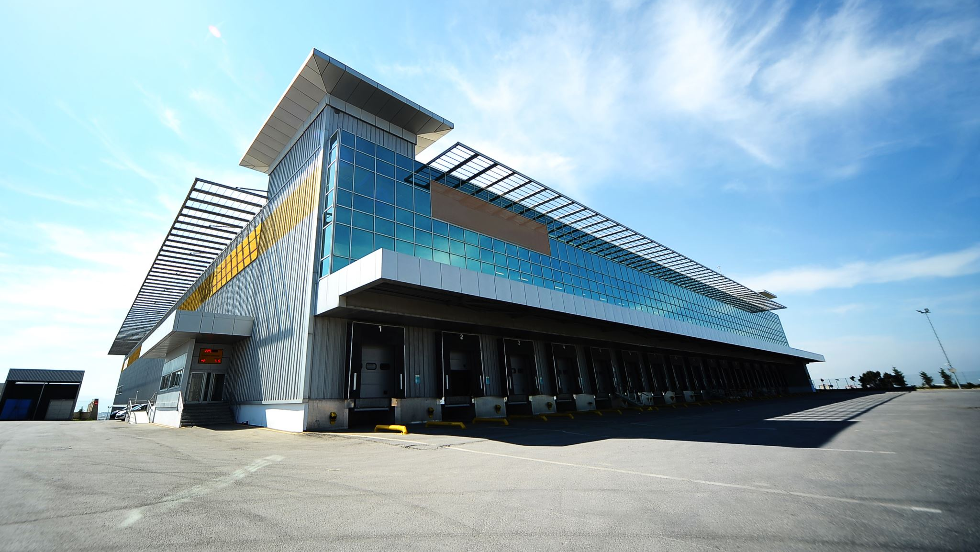
STATE WISE SALES FORECAST FOR ABC MFR

Slide 23
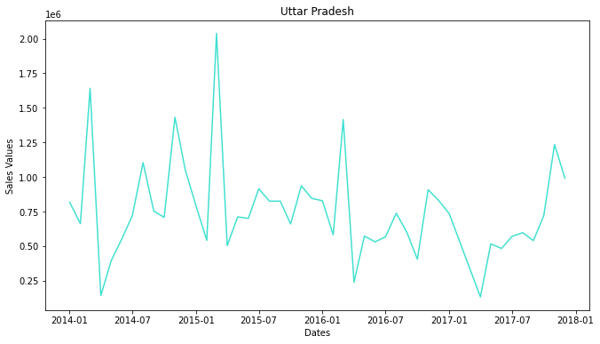
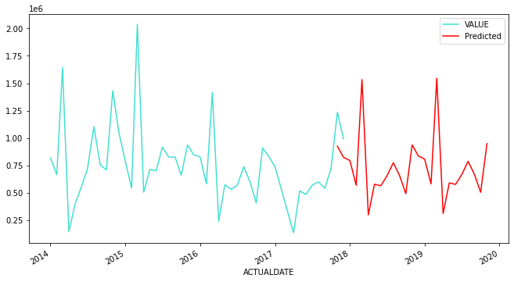
Project analysis slide 4
UTTAR PRADESH
TREND PLOT
FORECAST
The forecasted sales for year 2018 are within 296618 and 1532945
The forecasted sales for year 2019 are within 308925.8 and 1545253

Slide 24
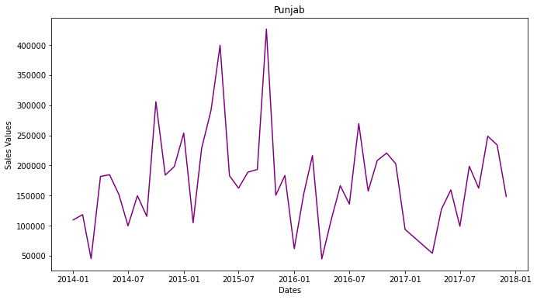
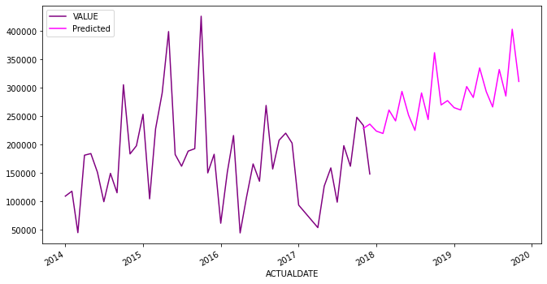
Project analysis slide 4
PUNJAB
TREND PLOT
FORECAST
The forecasted sales for year 2018 are within 219964 and 362181
The forecasted sales for year 2019 are within 261288 and 403505

Slide 25
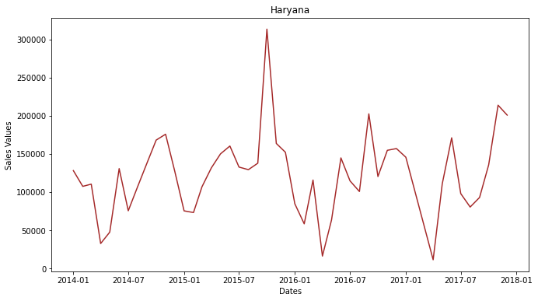
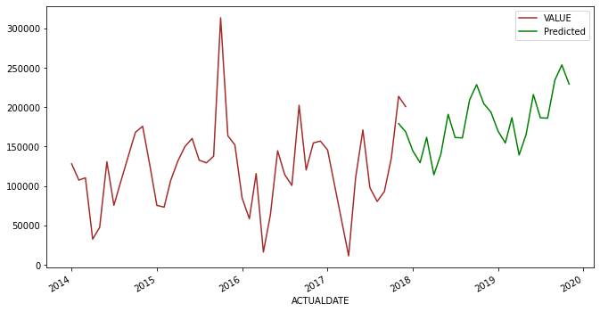
Project analysis slide 4
HARYANA
TREND PLOT
FORECAST
The forecasted sales for year 2018 are within 114211 and 228541
The forecasted sales for year 2019 are within 139231 and 253562

Slide 26
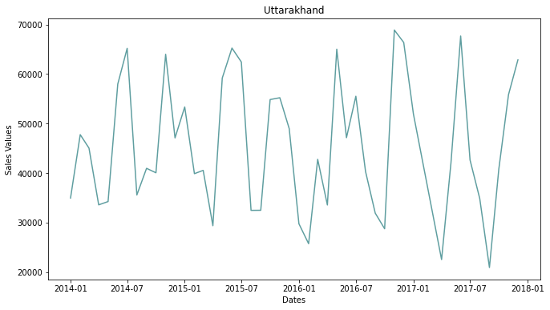
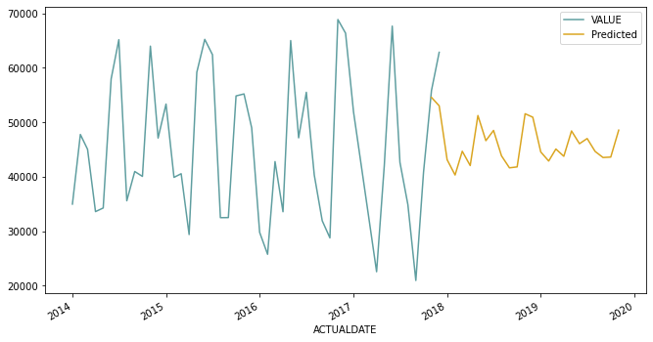
Project analysis slide 4
Uttarakhand
Uttarakhand
TREND PLOT
FORECAST
The forecasted sales for year 2018 are within 40310 and 51562
The forecasted sales for year 2019 are within 42876 and 48549

Slide 27
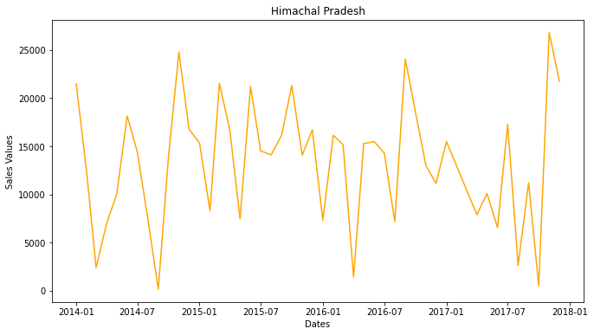
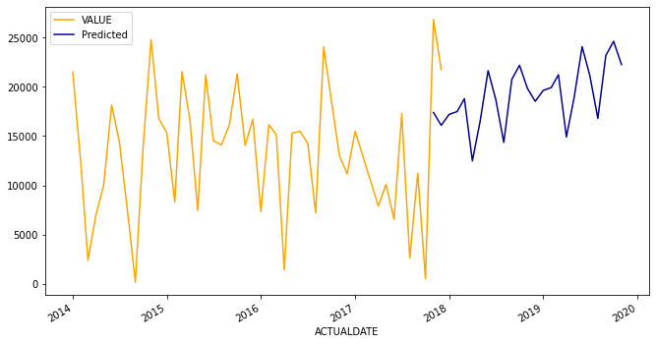
Project analysis slide 4
HIMACHAL PRADESH
TREND PLOT
FORECAST
The forecasted sales for year 2018 are within 12484 and 22197
The forecasted sales for year 2019 are within 14918 and 24632

Slide 28
Project analysis slide 4
TECHNICAL REFERENCE DOCUMENT
UTTAR PRADESH
HIMACHAL PRADESH
HARYANA
PUNJAB
UTTARAKHAND

Slide 29
Project analysis slide 4
CONCLUSIONS
ABC Manufacturing can work towards production of Bactericides, as they have 0 sales of bactericides in all five states for these four years.
On an average the pesticides are sold in Q4 in all these states by ABC Manufacturing, making it the profitable period for the company.
ABC Manufacturing must work in Punjab more to become market leader in pesticides sales as they are in other 4 states.
Uttar Pradesh is the states having highest sales of pesticides (all combined).
Insecticides are in highest demanded pesticides, irrespective of states. So all the states seems to have larger issues with Insects when it comes to Farming due to geographical conditions in these states.
ABC Manufacturing is the largest producer and seller of Insecticides as compared to other with more than 50% of the market share.
As Uttar Pradesh and Punjab are having highest land area under cultivation, ABC Manufacturing have high growth potential.
….to be continued

Slide 30
Project analysis slide 4
CONCLUSIONS
Although ABC is top most manufacturer in 4 states , based yearly trend of its Sales in 5 states ,there is a steep decrease in sales in UP and Punjab starting from 2015 indicating there is a little chance of sales increasing in upcoming years 2018 and 2019.
In Uttar Pradesh and Punjab, where ABC has a strongest foothold , they need to focus on all factors which has caused decrease in sales since 2015 and rethink their strategies for higher sales accordingly.
In rest of 3 states, the Sales for ABC over 4 years seems pretty consistent.

Slide 31
Thank You

